Slide 1
Chapter 17
Introduction to Transaction Processing Concepts and Theory

Slide 2
Chapter Outline
1 Introduction to Transaction Processing
2 Transaction and System Concepts
3 Desirable Properties of Transactions
4 Characterizing Schedules based on Recoverability
5 Characterizing Schedules based on Serializability
6 Transaction Support in SQL

Slide 3
Introduction to Transaction Processing
Single-User System:
At most one user at a time can use the system.
Multiuser System:
Many users can access the system concurrently.
Concurrency
Interleaved processing:
Concurrent execution of processes is interleaved in a single CPU
Parallel processing:
Processes are concurrently executed in multiple CPUs.

Slide 4
Introduction to Transaction Processing
A Transaction:
Logical unit of database processing that includes one or more access operations (read -retrieval, write - insert or update, delete).
A transaction (set of operations) may be stand-alone specified in a high level language like SQL submitted interactively, or may be embedded within a program.
Transaction boundaries:
Begin and End transaction.
An application program may contain several transactions separated by the Begin and End transaction boundaries.

Slide 5
Introduction to Transaction Processing
SIMPLE MODEL OF A DATABASE (for purposes of discussing transactions):
A database is a collection of named data items
Granularity of data - a field, a record , or a whole disk block (Concepts are independent of granularity)
Basic operations are read and write
read_item(X): Reads a database item named X into a program variable. To simplify our notation, we assume that the program variable is also named X.
write_item(X): Writes the value of program variable X into the database item named X.

Slide 6
Introduction to Transaction Processing
READ AND WRITE OPERATIONS:
Basic unit of data transfer from the disk to the computer main memory is one block. In general, a data item (what is read or written) will be the field of some record in the database, although it may be a larger unit such as a record or even a whole block.
read_item(X) command includes the following steps:
Find the address of the disk block that contains item X.
Copy that disk block into a buffer in main memory (if that disk block is not already in some main memory buffer).
Copy item X from the buffer to the program variable named X.

Slide 7
Introduction to Transaction Processing
READ AND WRITE OPERATIONS (contd.):
write_item(X) command includes the following steps:
Find the address of the disk block that contains item X.
Copy that disk block into a buffer in main memory (if that disk block is not already in some main memory buffer).
Copy item X from the program variable named X into its correct location in the buffer.
Store the updated block from the buffer back to disk (either immediately or at some later point in time).

Slide 8
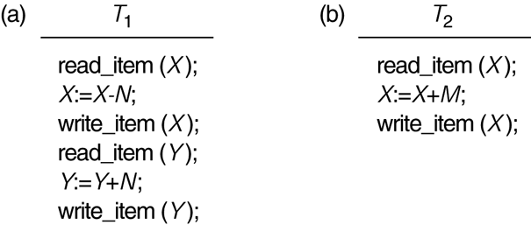
Two sample transactions
FIGURE 17.2 Two sample transactions:
(a) Transaction T1
(b) Transaction T2

Slide 9
Why Concurrency Control is needed?
Concurrent execution of transactions may lead to following problems:
Lost update problem
Temporary update problem
Incorrect summary problem

Slide 10
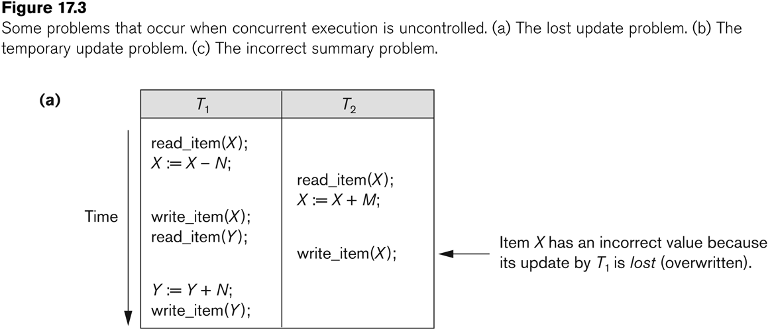
The Lost Update Problem
This occurs when two transactions that access the same database items have their operations interleaved in a way that makes the value of some database item incorrect.
X=100, M=5, N=10
T2 reads x before T1 writes X

Slide 11
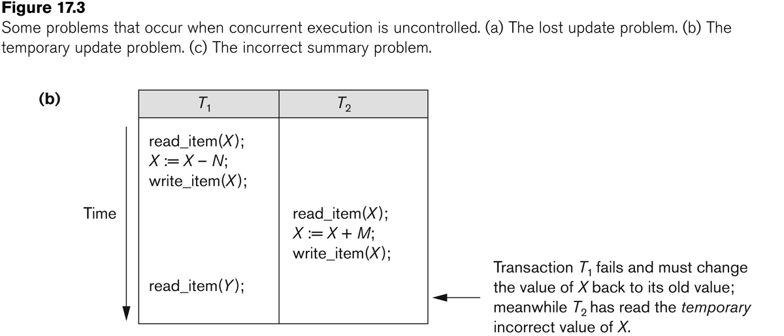
The Temporary Update (or Dirty Read) Problem
This occurs when one transaction updates a database item and then the transaction fails for some reason. The updated item is accessed by another transaction before it is changed back to its original value.
abort;

Slide 12
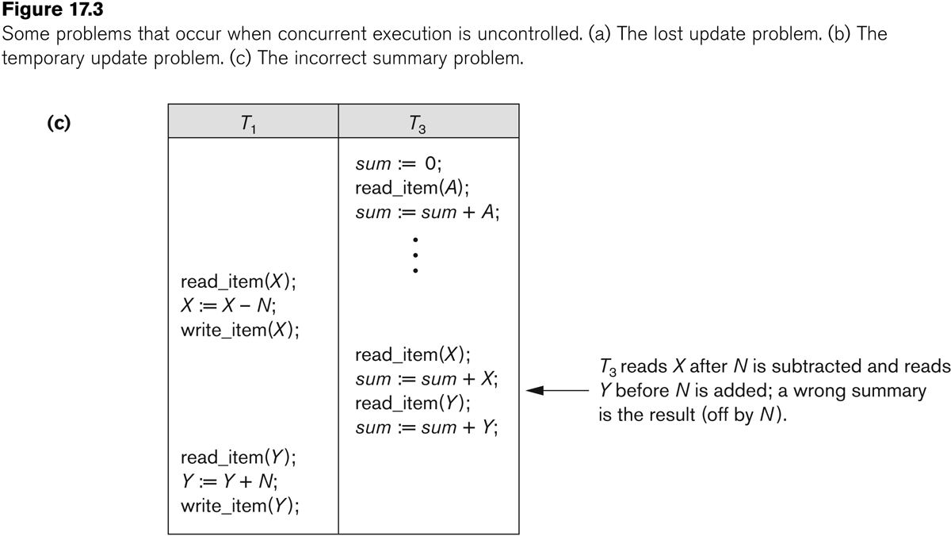
The Incorrect Summary Problem
If one transaction is calculating an aggregate summary function on a number of records while other transactions are updating some of these records, the aggregate function may calculate some values before they are updated and others after they are updated.

Slide 13
Introduction to Transaction Processing
Why recovery is needed:
(What causes a Transaction to fail)
1. A computer failure (system crash):
A hardware or software error occurs in the computer system during transaction execution. If the hardware crashes, the contents of the computer’s internal memory may be lost.
2. A transaction or system error:
Some operation in the transaction may cause it to fail, such as integer overflow or division by zero. Transaction failure may also occur because of erroneous parameter values or because of a logical programming error. In addition, the user may interrupt the transaction during its execution.

Slide 14
Introduction to Transaction Processing
Why recovery is needed (Contd.):
(What causes a Transaction to fail)
3. Local errors or exception conditions detected by the transaction:
Certain conditions necessitate cancellation of the transaction. For example, data for the transaction may not be found. A condition, such as insufficient account balance in a banking database, may cause a transaction, such as a fund withdrawal from that account, to be cancelled.
4. Concurrency control enforcement:
The concurrency control method may decide to abort the transaction, to be restarted later, because it violates serializability or because several transactions are in a state of deadlock.

Slide 15
Introduction to Transaction Processing
Why recovery is needed (contd.):
(What causes a Transaction to fail)
5. Disk failure:
Some disk blocks may lose their data because of a read or write malfunction or because of a disk read/write head crash. This may happen during a read or a write operation of the transaction.
6. Physical problems and catastrophes:
This refers to an endless list of problems that includes power or air-conditioning failure, fire, theft, sabotage, overwriting disks or tapes by mistake, and mounting of a wrong tape by the operator.

Slide 16
Transaction and System Concepts
A transaction is an atomic unit of work that is either completed in its entirety or not done at all.
For recovery purposes, the system needs to keep track of when the transaction starts, terminates, and commits or aborts.
Transaction states:
Active state
Partially committed state
Committed state
Failed state
Terminated State

Slide 17
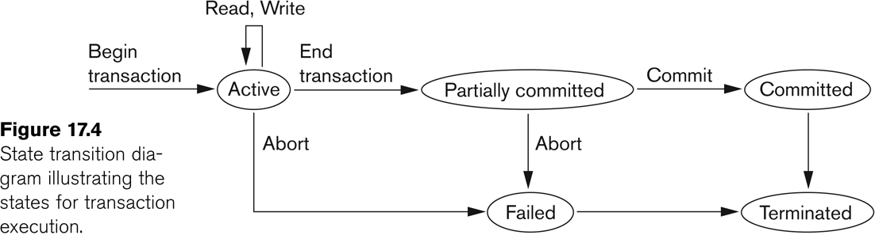
State transition diagram illustrating the states for transaction execution

Slide 18
Transaction and System Concepts
Recovery manager keeps track of the following operations:
begin_transaction: This marks the beginning of transaction execution.
read or write: These specify read or write operations on the database items that are executed as part of a transaction.
end_transaction: This specifies that read and write transaction operations have ended and marks the end limit of transaction execution.
At this point it may be necessary to check whether the changes introduced by the transaction can be permanently applied to the database or whether the transaction has to be aborted because it violates concurrency control or for some other reason.

Slide 19
Transaction and System Concepts
Recovery manager keeps track of the following operations (cont):
commit_transaction: This signals a successful end of the transaction so that any changes (updates) executed by the transaction can be safely committed to the database and will not be undone.
rollback (or abort): This signals that the transaction has ended unsuccessfully, so that any changes or effects that the transaction may have applied to the database must be undone.

Slide 20
Transaction and System Concepts
Recovery techniques use the following operators:
undo: Similar to rollback except that it applies to a single operation rather than to a whole transaction.
redo: This specifies that certain transaction operations must be redone to ensure that all the operations of a committed transaction have been applied successfully to the database.

Slide 21
State transition diagram illustrating the states for transaction execution

Slide 22
Transaction and System Concepts
The System Log
Log or Journal: The log keeps track of all transaction operations that affect the values of database items.
This information may be needed to permit recovery from transaction failures.
The log is kept on disk, so it is not affected by any type of failure except for disk or catastrophic failure.
In addition, the log is periodically backed up to archival storage (tape) to guard against such catastrophic failures.

Slide 23
Transaction and System Concepts
The System Log (cont):
T in the following discussion refers to a unique transaction-id that is generated automatically by the system and is used to identify each transaction:
Types of log record:
[start_transaction,T]: Records that transaction T has started execution.
[write_item,T,X,old_value,new_value]: Records that transaction T has changed the value of database item X from old_value to new_value.
[read_item,T,X]: Records that transaction T has read the value of database item X.
[commit,T]: Records that transaction T has completed successfully, and affirms that its effect can be committed (recorded permanently) to the database.
[abort,T]: Records that transaction T has been aborted.

Slide 24
Transaction and System Concepts
The System Log (cont):
Protocols for recovery that avoid cascading rollbacks do not require that read operations be written to the system log, whereas other protocols require these entries for recovery.
Strict protocols require simpler write entries that do not include new_value (see Section 17.4).

Slide 25
Transaction and System Concepts
Recovery using log records:
If the system crashes, we can recover to a consistent database state by examining the log and using one of the techniques described in Chapter 19.
Because the log contains a record of every write operation that changes the value of some database item, it is possible to undo the effect of these write operations of a transaction T by tracing backward through the log and resetting all items changed by a write operation of T to their old_values.
We can also redo the effect of the write operations of a transaction T by tracing forward through the log and setting all items changed by a write operation of T (that did not get done permanently) to their new_values.

Slide 26
Transaction and System Concepts
Commit Point of a Transaction:
Definition a Commit Point:
A transaction T reaches its commit point when all its operations that access the database have been executed successfully and the effect of all the transaction operations on the database has been recorded in the log.
Beyond the commit point, the transaction is said to be committed, and its effect is assumed to be permanently recorded in the database.
The transaction then writes an entry [commit,T] into the log.
Roll Back of transactions:
Needed for transactions that have a [start_transaction,T] entry into the log but no commit entry [commit,T] into the log.

Slide 27
Transaction and System Concepts
Commit Point of a Transaction (cont):
Redoing transactions:
Transactions that have written their commit entry in the log must also have recorded all their write operations in the log; otherwise they would not be committed, so their effect on the database can be redone from the log entries. (Notice that the log file must be kept on disk.
At the time of a system crash, only the log entries that have been written back to disk are considered in the recovery process because the contents of main memory may be lost.)
Force writing a log:
Before a transaction reaches its commit point, any portion of the log that has not been written to the disk yet must now be written to the disk.
This process is called force-writing the log file before committing a transaction.

Slide 28
Desirable Properties of Transactions
ACID properties:
Atomicity: A transaction is an atomic unit of processing; it is either performed in its entirety or not performed at all.
Consistency preservation: A correct execution of the transaction must take the database from one consistent state to another.
Isolation: A transaction should not make its updates visible to other transactions until it is committed; this property, when enforced strictly, solves the temporary update problem and makes cascading rollbacks of transactions unnecessary (see Chapter 21).
Durability or permanency: Once a transaction changes the database and the changes are committed, these changes must never be lost because of subsequent failure.

Slide 29
Characterizing Schedules based on Recoverability
Transaction schedule or history:
When transactions are executing concurrently in an interleaved fashion, the order of execution of operations from the various transactions forms what is known as a transaction schedule (or history).
A schedule (or history) S of n transactions T1, T2, …, Tn:
It is an ordering of the operations of the transactions subject to the constraint that, for each transaction Ti that participates in S, the operations of T1 in S must appear in the same order in which they occur in T1.
Note, however, that operations from other transactions Tj can be interleaved with the operations of Ti in S.

Slide 30
Schedules classified on recoverability:
Recoverable schedule:
One where no transaction needs to be rolled back.
A schedule S is recoverable if no transaction T in S commits until all transactions T’ that have written an item that T reads have committed.
Cascadeless schedule:
One where every transaction reads only the items that are written by committed transactions.

Slide 31
Schedules classified on recoverability (contd.):
Schedules requiring cascaded rollback:
A schedule in which uncommitted transactions that read an item from a failed transaction must be rolled back.
Strict Schedules:
A schedule in which a transaction can neither read or write an item X until the last transaction that wrote X has committed.

Slide 32
Serial schedule:
A schedule S is serial if, for every transaction T participating in the schedule, all the operations of T are executed consecutively in the schedule.
Otherwise, the schedule is called nonserial schedule.
Serializable schedule:
A schedule S is serializable if it is equivalent to some serial schedule of the same n transactions.

Slide 33
T1 | T2
R(B)
 | W(B)
FOR A CONFLICT TO EXIST
MIN 2 TRANS
BOTH SHOULD ACCESS SAME DATAITEM
ONE OF THE OPERATION SHOULD BE A WRITE

Slide 34
Result equivalent:
Two schedules are called result equivalent if they produce the same final state of the database.
Conflict equivalent:
Two schedules are said to be conflict equivalent if the order of any two conflicting operations is the same in both schedules.
Conflict serializable:
A schedule S is said to be conflict serializable if it is conflict equivalent to some serial schedule S’.

Slide 35
Being serializable is not the same as being serial
Being serializable implies that the schedule is a correct schedule.
It will leave the database in a consistent state.
The interleaving is appropriate and will result in a state as if the transactions were serially executed, yet will achieve efficiency due to concurrent execution.

Slide 36
Serializability is hard to check.
Interleaving of operations occurs in an operating system through some scheduler
Difficult to determine beforehand how the operations in a schedule will be interleaved.

Slide 37
VIEW SERIALIZABLE
CONFLICT
SERIALIZABLE
CONSISTENT
INCONSISTENT

Slide 38
Serial schedules always leave database in a CONSISTENT STATE
Non-Serial (i.e. Concurrent) Schedules can be consistent or they can be inconsistent
Non-Serial (i.e. Concurrent) Schedules if consistent they are either Conflict Equivalent or atleast View Equivalent
Every Non-Serial (i.e. Concurrent) Schedules should be first checked for Conflict Equivalence.
Every Non-Serial (i.e. Concurrent) Schedules which is conflict equivalent shall always be a consistent schedule.

Slide 39
A Non-Serial (i.e. Concurrent) Schedule which is not CONFLICT EQUIVALENT can either be consistent or inconsistent schedule.
A Non-Serial (i.e. Concurrent) Schedules which is not CONFLICT EQUIVALENT should be checked for view equivalence.
A Non-Serial (i.e. Concurrent) Schedules which is not CONFLICT EQUIVALENT if it does not have a blind write shall never be VIEW EQUIVALENT
A Non-Serial (i.e. Concurrent) Schedules which is not CONFLICT EQUIVALENT if it has a blind write it may be VIEW EQUIVALENT and hence consistent.
A Non-Serial (i.e. Concurrent) Schedules which is neither CONFLICT EQUIVALENT nor VIEW EQUIVALENT can either be consistent or inconsistent.

Slide 40
Consider the following schedule of three transactions
Here, the operations W2(A) and W3(A) are blind writes, since T2 and T3 do not read the value of A.
This is a view serializable schedule, since it is view equivalent to the serial schedule T1-> T2->T3.
However, it is not conflict serializable, since it is not conflict equivalent to any serial schedule.
T1 | T2 | T3
R(A)
 | W(A)
W(A)
 |  | W(A)

Slide 41
Practical approach:
Come up with methods (protocols) to ensure serializability.
It’s not possible to determine when a schedule begins and when it ends.
Hence, we reduce the problem of checking the whole schedule to checking only a committed project of the schedule (i.e. operations from only the committed transactions.)
Current approach used in most DBMSs:
Use of locks with two phase locking

Slide 42
Testing for conflict serializability: Algorithm :
Looks at only read_Item (X) and write_Item (X) operations
Constructs a precedence graph (serialization graph) - a graph with directed edges
An edge is created from Ti to Tj if one of the operations in Ti appears before a conflicting operation in Tj
The schedule is serializable if and only if the precedence graph has no cycles.

Slide 43
Examples on Constructing the Precedence Graphs

Slide 44
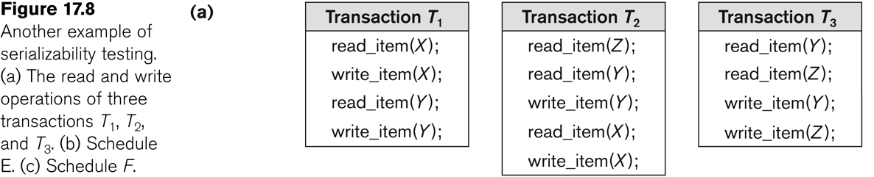
Another example of serializability Testing

Slide 45
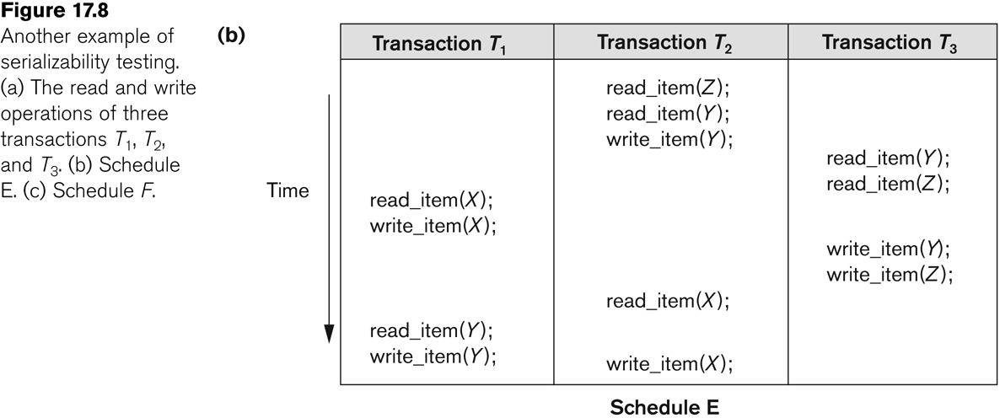
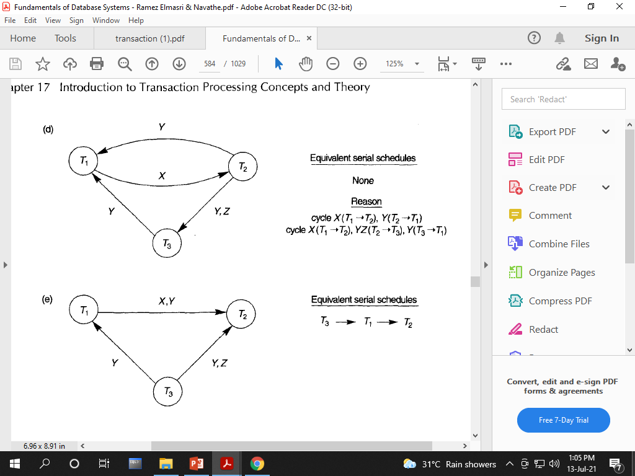

Slide 46
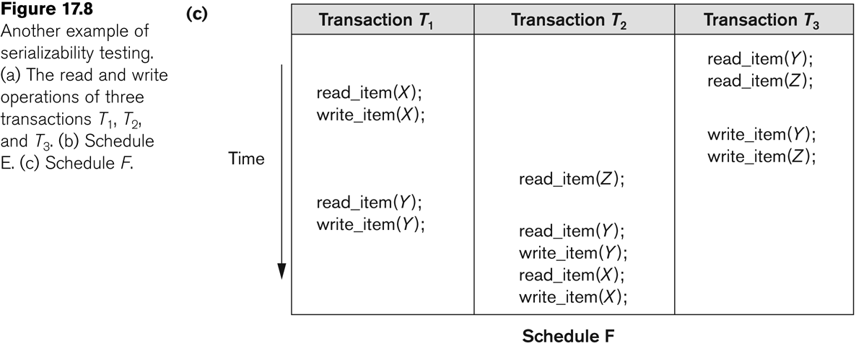

Slide 47
View equivalence:
A less restrictive definition of equivalence of schedules
View serializability:
Definition of serializability based on view equivalence.
A schedule is view serializable if it is view equivalent to a serial schedule.

Slide 48
Two schedules are said to be view equivalent if the following three conditions hold:
(Initial Reads should be performed by same transactions in both schedules-Initial read is the reading of an item before it is written by any transaction)
The same set of transactions participates in S and S’, and S and S’ include the same operations of those transactions.
(Intermediate Reads should be same. Same number of W-R Conflict should exist between 2 transactions between both schedules)
For any operation Ri(X) of Ti in S, if the value of X read by the operation has been written by an operation Wj(X) of Tj (or if it is the original value of X before the schedule started), the same condition must hold for the value of X read by operation Ri(X) of Ti in S’.
(Final write operation should be performed by the same transaction in both schedules)
If the operation Wk(Y) of Tk is the last operation to write item Y in S, then Wk(Y) of Tk must also be the last operation to write item Y in S’.

Slide 49
S1
S2
T1 | T2 | T3
 |  | R(X)
 | R(X)
 |  | W(X)
R(X)
W(X)
T2 | T3 | T1
 | R(X)
R(X)
 | W(X)
 |  | R(X)
 |  | W(X)
Same Initial Reads
Same W-R Conflicts
Same Final Write
S1 AND S2 are View Equivalent

Slide 50
S1
S2
T1 | T2
R(A)
W(A)
 | R(A)
 | W(A)
R(B)
W(B)
 | R(B)
 | W(B)
T1 | T2
R(A)
W(A)
R(B)
W(B)
 | R(A)
 | W(A)
 | R(B)
 | W(B)
Check whether above schedules are view equivalent or not.

Slide 51
S1
S2
T1 | T2
R(A)
W(A)
 | R(A)
 | W(A)
R(B)
W(B)
 | R(B)
 | W(B)
T1 | T2
R(A)
W(A)
R(B)
W(B)
 | R(A)
 | W(A)
 | R(B)
 | W(B)
S1 & S2 are view equivalent
Initial Read on A is by T1 in both S1 & S2.
Initial Read on B is by T1 in both S1 & S2
Final write on A is by T2 in both S1 & S2.
Final write on B is by T2 in both S1 & S2
Intermediate Read –T2 read A written by T1 in both S1 & S2.
Intermediate Read –T2 read B written by T1 in both S1 & S2.

Slide 52
Check whether schedule is view equivalent to any serial schedule.
T1 | T2 | T3
R(A)
 | W(A)
W(A)
 |  | W(A)
Now for 3 transactions we can have 3! =6 serial schedules and to answer our question we need to draw all serial schedules first.

Slide 53
NOTE:
In real life scenario a schedule may have 50000 transactions running concurrently and if we are asked to check whether a given schedule is view equivalent to any serial schedule we shall have to draw 50000!(factorial of 50000) serial schedules and check our schedule with all those schedules.
THIS IS NP-COMPLETE COMPLEX PROBLEM AND PRACTICALLY ALMOST IMPOSSIBLE FOR ANY COMPUTER TO SOLVE. HENCE VIEW SERIALIZABILITY IS NOT PRACTICALLY USED.

Slide 54
The premise behind view equivalence:
As long as each read operation of a transaction reads the result of the same write operation in both schedules, the write operations of each transaction must produce the same results.
“The view”: the read operations are said to see the same view in both schedules.

Slide 55
Consider the following schedule of three transactions
Here, the operations W2(A) and W3(A) are blind writes, since T2 and T3 do not read the value of A.
This is a view serializable schedule, since it is view equivalent to the serial schedule T1-> T2->T3.
However, it is not conflict serializable, since it is not conflict equivalent to any serial schedule.
T1 | T2 | T3
R(A)
 | W(A)
W(A)
 |  | W(A)

Slide 56
Check whether schedule is VIEW EQUIVALENT to any serial schedule.
T1 | T2 | T3
R(A)
 | W(A)
W(A)
 |  | W(A)
Now for 3 transactions we can have 3! =6 serial schedules and to answer our question we need to draw all serial schedules first.

